Slide 1

SCHOOL OF INFORMATICS
DEPARTMENT OF COMPUTER SCIENCE
COURSE ADVANCED DATABASE
NAME TIGIST WOLDE

Slide 2
INTRODUCTION
A Hospital Management System (HMS) is an integrated software solution designed to streamline the operational, administrative, and clinical functions of a hospital. It serves as a centralized platform to manage vital hospital activities such as patient records, doctor information, appointments, diagnoses, and treatments. By digitizing and automating key hospital processes, the system enhances efficiency, reduces errors, and improves the overall quality of healthcare services. In the modern healthcare environment, where timely access to accurate information is crucial, an HMS plays a critical role in ensuring seamless coordination between different hospital departments.

Slide 3
Purpose
The main purpose of this project is to design and implement a database-driven Hospital Management System that:
Organizes and stores patient, doctor, and treatment records systematically.
Facilitates smooth appointment scheduling between patients and doctors.
Tracks diagnoses and treatment histories accurately.
Ensures data consistency and accessibility for better hospital decision-making.
Reduces manual paperwork, administrative burden, and human error.

Slide 4
Significance
This project is significant for several reasons:
Improved Patient Care: Doctors can quickly access patient histories, leading to faster and better treatment decisions.
Operational Efficiency: Automates routine tasks, saving time and resources for hospital staff.
Data Integrity: Maintains a consistent and error-free database for all medical records.
Real-Time Access: Enables real-time tracking of appointments, treatments, and diagnoses.
Scalability: The system can be expanded in the future to support billing, pharmacy, lab tests, and more.
Support for Research: Data collected can be used to analyze health trends, manage resources, and improve services.

Slide 5
3. Database Implementation
• Relational Schema:
• Doctors:
* DoctorID (PK)
* DoctorName
* Specialization
* ConsultationLimit
• Patients:
* PatientID (PK)
* PatientName
* AdmissionDate

Slide 6
• Appointments:
* AppointmentID (PK)
* DoctorID (FK references Doctors.DoctorID)
* PatientID (FK references Patients.PatientID)
* AppointmentDate

Slide 7
• Diagnoses:
* DiagnosisID (PK)
* PatientID (FK references Patients.PatientID)
* Disease
• Treatments:
* TreatmentID (PK)
* DiagnosisID (FK references Diagnoses.DiagnosisID)
* TreatmentName
* ServiceCharge

Slide 8
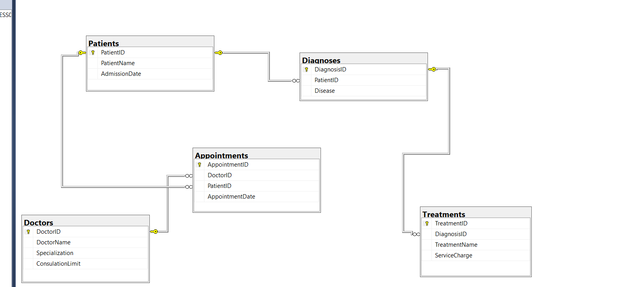
Database Diagrams

Slide 9
Data type and constraints
| Table | Column | Data Type | Constraints | Description |
| ------------- | ----------------- | ------------ | -------------------------------------------- | --------------------------------------------------------------------------------------- |
| Doctors | DoctorID | INT | PRIMARY KEY, NOT NULL, AUTO_INCREMENT (if applicable) | Unique identifier for each doctor
|
| Doctors | DoctorName | VARCHAR(255) | NOT NULL | Name of the doctor |

Slide 10
| Doctors | Specialization | VARCHAR(255) | NOT NULL | Doctor's area of specialization (e.g., Cardiology, Neurology)
|
| Doctors | ConsultationLimit | INT | NOT NULL, CHECK (ConsultationLimit > 0) | Maximum number of consultations a doctor can handle (ensures a positive number) |
| Patients | PatientID | INT | PRIMARY KEY, NOT NULL, AUTO_INCREMENT (if applicable) | Unique identifier for each patient
| Patients | PatientName | VARCHAR(255) | NOT NULL | Name of the patient |
| Patients | AdmissionDate | DATE | NOT NULL | Date when the patient was admitted to the hospital |
|

Slide 11
| Appointments | AppointmentID | INT | PRIMARY KEY, NOT NULL, AUTO_INCREMENT (if applicable) | Unique identifier for each appointment |
| Appointments | DoctorID | INT | NOT NULL, FOREIGN KEY (references Doctors.DoctorID) | ID of the doctor for the appointment |
| Appointments | PatientID | INT | NOT NULL, FOREIGN KEY (references Patients.PatientID) | ID of the patient for the appointment |
| Appointments | AppointmentDate | DATETIME | NOT NULL | Date and time of the appointment |

Slide 12
| Diagnoses | DiagnosisID | INT | PRIMARY KEY, NOT NULL, AUTO_INCREMENT (if applicable) | Unique identifier for each diagnosis |
| Diagnoses | PatientID | INT | NOT NULL, FOREIGN KEY (references Patients.PatientID) | ID of the patient who received
he diagnosis |
| Diagnoses | Disease | VARCHAR(255) | NOT NULL | Name of the disease diagnosed

Slide 13
| Treatments | TreatmentID | INT | PRIMARY KEY, NOT NULL, AUTO_INCREMENT (if applicable) | Unique identifier for each treatment |
| Treatments | DiagnosisID | INT | NOT NULL, FOREIGN KEY (references Diagnoses.DiagnosisID) | ID of the diagnosis for which the treatment is being provided

Slide 14
| Treatments | TreatmentName | VARCHAR(255) | NOT NULL | Name of the treatment administered |
| Treatments | ServiceCharge | DECIMAL(10,2) | NOT NULL, CHECK (ServiceCharge >= 0) | Cost of the treatment (ensures a non-negative value)|

Slide 15
SQL query
. create database HospitalManagement;
use HospitalManagement;
create table Doctors ( DoctorID int primary key,
DoctorName varchar(100),
Specialization varchar(150), ConsulationLimit int);
create table Patients(
PatientID int primary key,
PatientName varchar(100),
AdmissionDate date
);

Slide 16
create table Appointments (
AppointmentID int primary key,
DoctorID int,
PatientID int,
AppointmentDate date,
foreign key (DoctorID)
references Doctors(DoctorID),
Foreign key (PatientID)
references Patients(PatientID)
);
create table Diagnoses (
DiagnosisID int primary key,
PatientID int,
Disease varchar(100),
foreign key (PatientID)
references Patients(PatientID)
);

Slide 17
create table Treatments (
TreatmentID int primary key,
DiagnosisID int;
TreatmentName varchar(100),
ServiceCharge decimal(10,2),
foreign key (DiagnosisID)
references Diagnoses(DiagnosisID)
);

Slide 18
SELECT * FROM Doctors;
insert into Doctors Values (001,'Dr Desta Lema' ,'Neurology', 90);
insert into Doctors Values (002,'Dr. Mesay Guche', 'Cardiology',70);
insert into Doctors Values (003,'Dr. Wachifa Boru', 'General Medicine', 150);
insert into Doctors Values (004,'Dr. Desta Lema', 'Endocrinology', 100);
insert into Doctors Values (005,'Dr. Bontu Duresa', 'Dermatology', 110);
insert into Doctors Values (006,'Dr. Dheresa Udesa', 'Cardiology', 85);
insert into Doctors Values (007,'Dr. Bontu Duresa', 'Neurology', 30);
insert into Doctors Values (008,'Dr. Tariku Dukale', 'Orthopdic', 45);
insert into Doctors Values (009,'Dr. Lali Areri', 'Nephrology', 70);
insert into Doctors Values (010,'Dr. Geda Zenebe', 'Dentelogy', 90);

Slide 19
SELECT * FROM Patients;
insert into Patients values (0001,'Nuguse Tamirat','12-11-2017');
insert into Patients values (0002,'Addisu Shimelis','09-11-2017');
insert into Patients values (0003,'Genet Gebayo','08-12-2017');
insert into Patients values (0004,'Mulunesh Dulecha','10-02-2018');
insert into Patients values (0005,'Esmael Abdela','07-08-2018');
insert into Patients values (0006,'Tolosa Safo','09-11-2017');
insert into Patients values (0007,'Sabontu Duba','01-03-2018');
insert into Patients values (0008,'Bilise Dhuguma','08-11-2017');
insert into Patients values (0009,'Abdi Abebe','02-09-2017');
insert into Patients values (0010,'Abdisa Tadese','10-01-2018');

Slide 20
SELECT * FROM Appointments;
insert into Appointments values (022,001,0001, '12-10-2017');
insert into Appointments values (023,002,0002, '03-09-2017');
insert into Appointments values (024,003,0003, '01-10-2017');
insert into Appointments values (025,004,0004, '04-08-2017');
insert into Appointments values (026,005,0005, '06-11-2017');
insert into Appointments values (027,006,0006, '11-11-2017');
insert into Appointments values (028,007,0007, '06-09-2017');
insert into Appointments values (029,008,0008, '09-01-2018');
insert into Appointments values (031,009,0009, '05-11-2017');
insert into Appointments values (032,010,0010, '11-03-2018');

Slide 21
SELECT * FROM Diagnoses;
insert into Diagnoses values (41,0001, 'Heart Disease');
insert into Diagnoses values (42,0002, 'Flu');
insert into Diagnoses values (43,0003, 'Malaria');
insert into Diagnoses values (44,0004, 'TB');
insert into Diagnoses values (45,0005, 'Brain Tumor');
insert into Diagnoses values (46,0006, 'Diabetes');
insert into Diagnoses values (47,0007, 'Typhoid Fever');
insert into Diagnoses values (48,0008, 'Asthma');
insert into Diagnoses values (49,0009, 'COVID-19');
insert into Diagnoses values (50,0010, 'HIV/AIDS');

Slide 22
SELECT * FROM Treatments
insert into Treatments values (001,41, 'Heart Surgery', 50000.00);
insert into Treatments values (002,42, 'Flu Medication', 100.00);
insert into Treatments values (003,43, 'Malaria Medication', 300.00);
insert into Treatments values (004,44, 'TB Medication', 400.00);
insert into Treatments values (005,45, 'Brain Surgery', 80000.00);
insert into Treatments values (006,46, 'Insulin', 5000.00);
insert into Treatments values (007,47, 'Antibiotics', 250.00);
insert into Treatments values (008,48, 'Corticosteroids', 700.00);
insert into Treatments values (009,49, 'Supportive Care', 2000.00);
insert into Treatments values (010,50, 'ART', 1000.00);

Slide 23
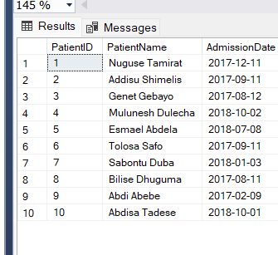
Result of sql query
1. Select all Patients admitted to the hospital.
select * from patients;
select * from Patients;

Slide 24
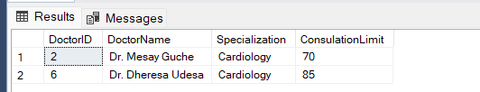
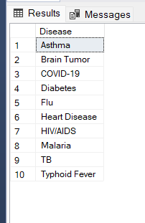
--2. Select all doctors specializing in "Cardiology."
select * from Doctors where Specialization='Cardiology';
--3. Select all distinct diseases treated in the hospital.
select distinct Disease from Diagnoses;

Slide 25

--4. Select the total number of patients treated in the hospital.
select count(distinct PatientID) as TotalPatients from Diagnoses;
--5. Select the doctor's name and the number of patients they have treated.
select d.DoctorName,
count(a.PatientID) AS
NumberOfPatients
FROM Doctors d
LEFT JOIN Appointments a on d.DoctorID = a.DoctorID
GROUP BY d.DoctorID,D.DoctorName;

Slide 26
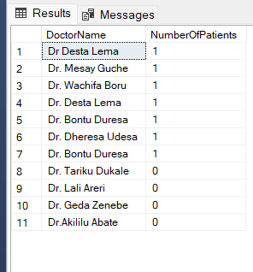
--6. Select only doctors who have treated more than50 patients.
select d.DoctorName,
count(a.PatientID) AS NumberofPatients
from Doctors d
INNER JOIN Appointments a ON d.DoctorID=a.DoctorID
GROUP BY d.DoctorID,d.DoctorName
HAVING count(a.PatientID) > 50;

Slide 27

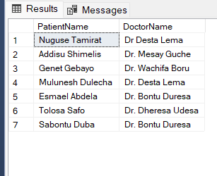
--7.Select the names of all patients along with their assigned doctor.
select p.PatientName, d.DoctorName
from Patients p
join Appointments a ON P.patientID=a.patientID
join doctors d ON a.doctorID=
d.DoctorID;

Slide 28
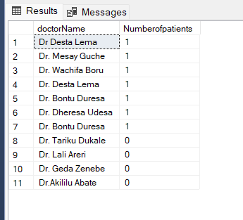
--8.Select all doctors along with the number of patients they have (including doctors with no Patients).
select d.doctorName,
COUNT(a.patientID) AS
Numberofpatients
FROM Doctors d
LEFT JOIN Appointments a ON
d.doctorID=a.doctorID
GROUP BY d.doctorID,d.DoctorName;

Slide 29

--9. Select all doctors whose patient count exceeds their consultation limit.
SELECT d.DoctorName, d.ConsulationLimit, sq.PatientCount
FROM Doctors d
INNER JOIN (
SELECT d.DoctorID, COUNT(a.PatientID) AS PatientCount
FROM Doctors d
INNER JOIN Appointments a ON d.DoctorID = a.DoctorID
GROUP BY d.DoctorID
) sq ON d.DoctorID = sq.DoctorID
WHERE sq.PatientCount > d.ConsulationLimit;

Slide 30
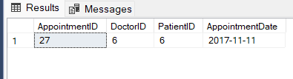
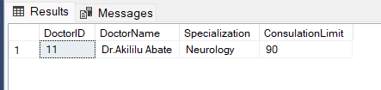
--10.Select all Appointments scheduled for today.
select * from Appointments where AppointmentDate = '2017-11-11';
--11. Add a new doctor specializing in "Neurology."
insert into Doctors (DoctorID,DoctorName,
Specialization,ConsulationLimit)
values (011,'Dr.Akililu Abate','Neurology',90);

Slide 31
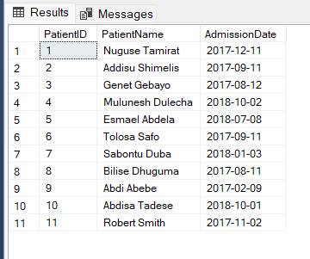
--12. Add a new patient " Robert smith" assigned to "Dr.Williams."
insert into Patients (PatientID,PatientName,AdmissionDate)
values (0011,'Robert Smith', '11-02-2017');
insert into Appointments (AppointmentID,DoctorID,PatientID,Appointmentdate)
values (033, (select DoctorID from Doctors where DoctorName='Dr.Williams')0011, '11-02-2017');

Slide 32
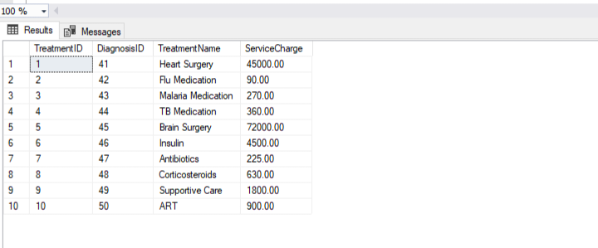
.13 Reduce hospital service charges by 10%
update Treatments
SET servicecharge = servicecharge *0.9;

Slide 33

-14. Apply a 15% discount to patients who have more than five visits in the last year.
UPDATE Treatments
SET ServiceCharge = ServiceCharge * 0.85
WHERE DiagnosisID IN (
SELECT d.DiagnosisID
FROM Diagnoses d
INNER JOIN Patients p ON d.PatientID = p.PatientID
INNER JOIN Appointments a ON p.PatientID = a.PatientID
WHERE a.AppointmentDate >= DATEADD(year, -1, GETDATE()) --This now has correct closing bracket.
GROUP BY p.PatientID,d.DiagnosisID
HAVING COUNT(*) > 5);

Slide 34

15Remove all patient who have not visted in the last two years
DELETE FROM Patients
WHERE PatientID NOT IN (
SELECT DISTINCT PatientID
FROM Appointments
WHERE AppointmentDate >=
DATEADD(YEAR,-2, GETDATE())
);

Slide 35
--16. Remove all patients from doctors who have exceeded their consultation limit.
DELETE FROM Appointments
WHERE DoctorID IN (
SELECT d.DoctorID
FROM Doctors d
JOIN (
SELECT DoctorID,
COUNT(PatientID) AS PatientCount
FROM Appointments
GROUP BY DoctorID
) sq ON d.DoctorID = sq.DoctorID
WHERE sq.PatientCount >
d.ConsulationLimit
);

Slide 36
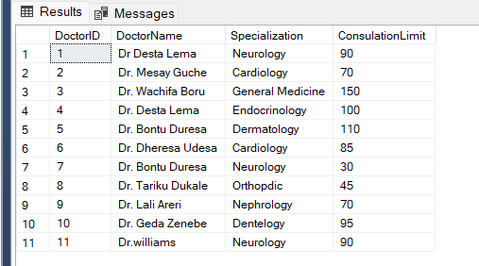

Slide 37
DEPLOYMENT STRANGE
1. Database Deployment
Manual Method
• Step 1: Install a SQL Server instance (e.g., Microsoft SQL Server).
• Step 2: Use SQL Server Management Studio (SSMS) to:
• Create the Hospital Management database.
• Run the provided SQL script to create tables, insert data, and execute queries.
• Step 3: Validate the deployment:
• Check tables (e.g., SELECT * FROM Doctors;).
• Verify constraints (e.g., foreign keys in Appointments).

Slide 38
Automated Method
Step 1: Store the SQL script in a version control system (e.g., GitHub).
Step 2: Use
• Automatically create the database on a target server.
• Execute the SQL script using a tool like sqlcmd or Invoke-SqlCmd (PowerShell).
Step 3: Validate with automated tests (e.g., check table counts, constraint integrity).

Slide 39
CONCLUSION
Summary of Project Objective and Outcome
.Objective:
The project aims to create a relational database system for managing hospital operations, including tracking doctors, patients, appointments, diagnoses, and treatments. It focuses on organizing medical workflows, managing doctor-patient interactions, and automating administrative tasks like calculating service charges and enforcing consultation limits.
Outcome:
• A functional database schema with tables for Doctors, Patients, Appointments, Diagnoses, and Treatments.
• Sample data inserted to simulate real-world scenarios.
• SQL queries to retrieve crcriticlinformation (e.g., patient-doctor
assignments, disease statistics,
consultation limits).
.Data manipulation operations (e.g., discounts, deletions, updates) to automate hospital policies.
• Basic analytics, such as counting patients per doctor or identifying doctors exceeding consultation limits.

Slide 40
Future Considerations and Improvements
1. Schema Enhancements:
• Add indexes to improve query performance (e.g., on AppointmentDate, Specialization).
• Normalize tables to reduce redundancy (e.g., avoid duplicate doctor names like "Dr. Bontu Duresa").
• Add constraints for data validation (e.g., enforce AdmissionDate < current date).
2. Error Handling:
• Fix syntax issues in existing queries
.Standardize date formats
3. Advanced Features:
• Implement stored procedures for recurring tasks (e.g., adding new patients or doctors).
• Add triggers to automate updates (e.g., adjust consultation counts when appointments are added/deleted).
• Introduce user roles and permissions for data security.
4. Scalabilit
• Partition large tables (e.g., Appointments)

Slide 41
5, Integration:
• Build a frontend interface for non-technical staff.
• Connect to external systems
.6, Data Integrity:
• Use transactions to ensure atomicity in critical operations (e.g., patient deletions).
• Add foreign key constraints where missing (e.g., Diagnosis ID in Treatments is properly linked).

Slide 42
THANK YOU

